Slide 1
Tiny College (TC)
Tiny College is divided into several schools: business, arts and sciences, education, applied sciences. Each school is administered by a dean. The dean is one of the professors.
Each school comprises several departments (e.g. business has the accounting, management, and economics departments). Each professor is employed by a department; one professor is the department chair.
Each department offers courses. A course may be divided into multiple classes (sections). Each professor may teach up to 4 classes; a professor may be on research contract and teach no classes at all.
A student may enroll in up to 6 classes; a class may have no more than 35 students.
A student may declare a major (only one!). Each major is associated with a specific department. Each student has an adviser, who is one of the professors.
Each class is taught in a room, located in a building.

Slide 2
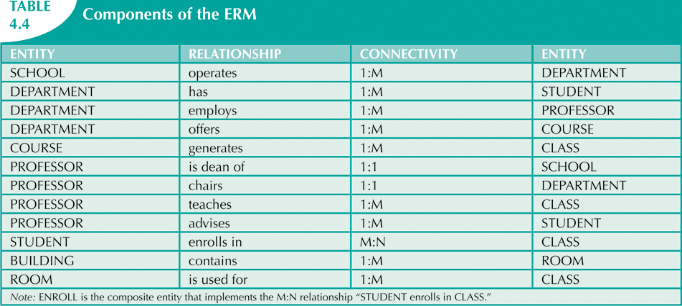

Slide 3
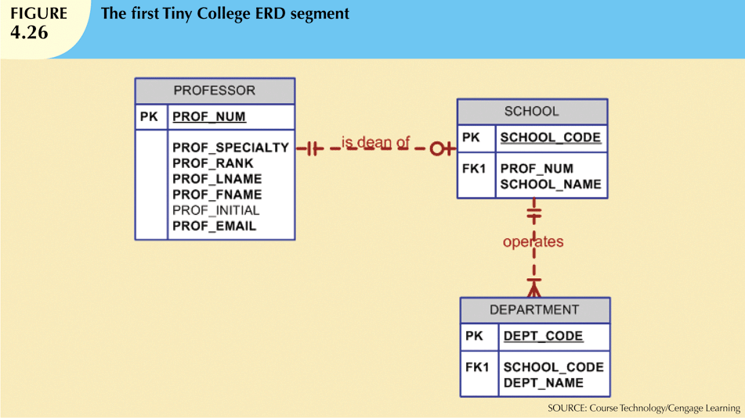

Slide 4
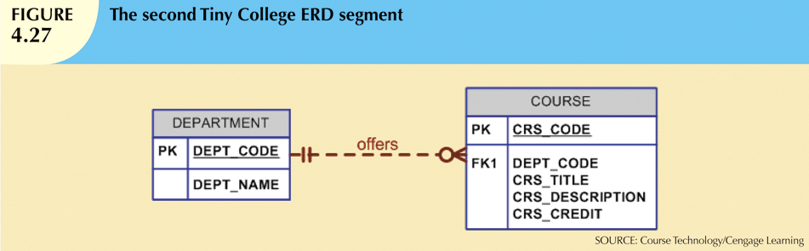
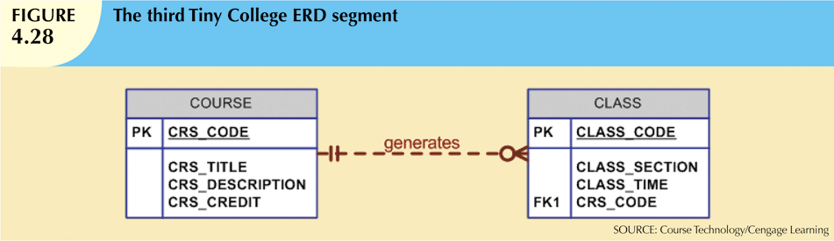

Slide 5
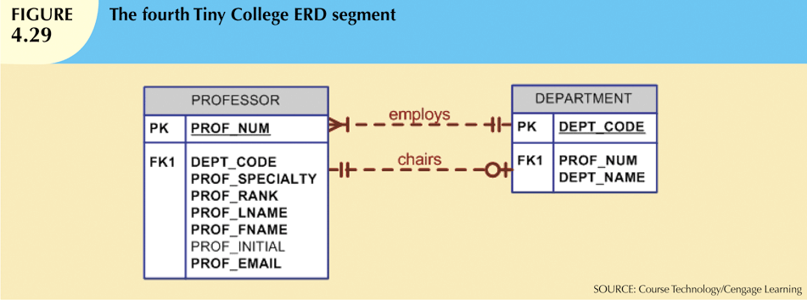
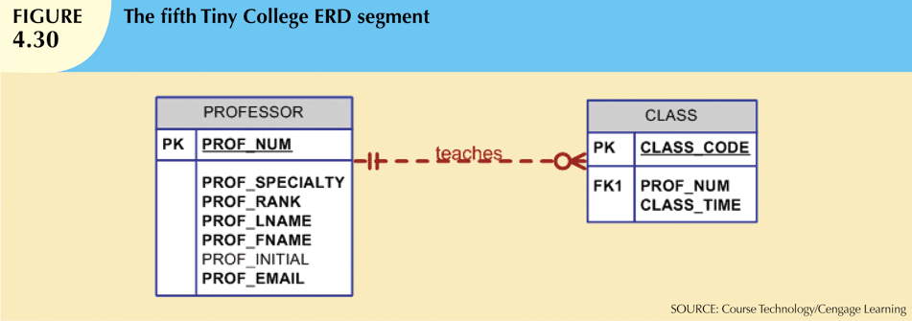

Slide 6
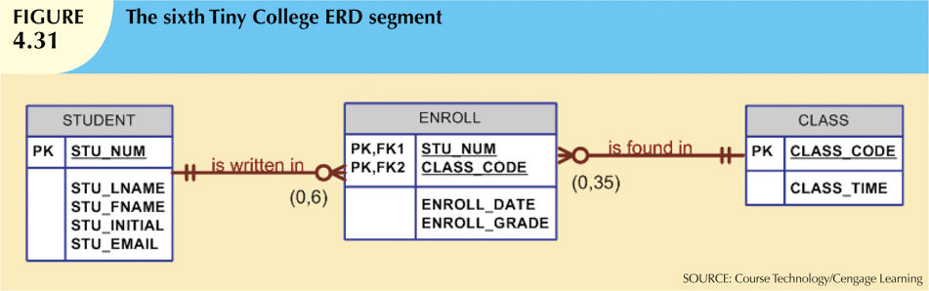
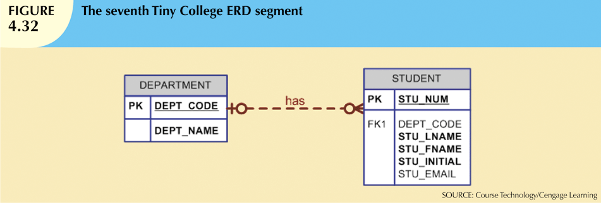

Slide 7
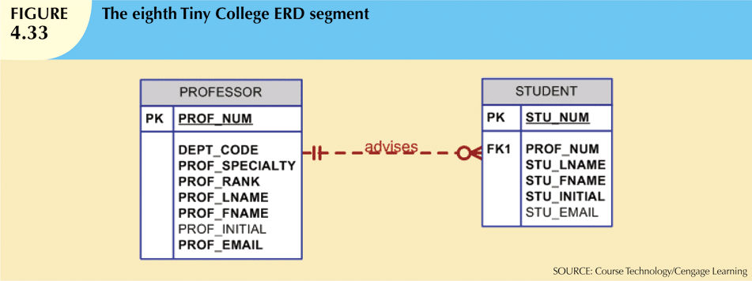
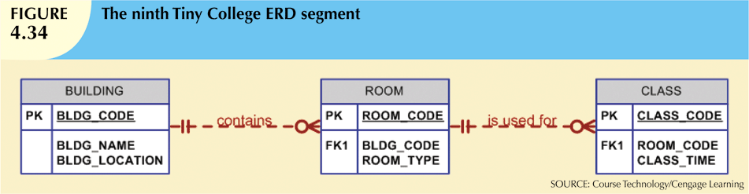

Slide 8
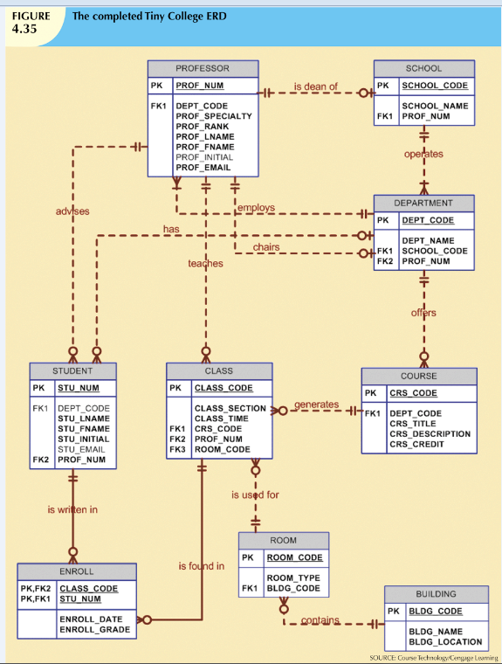
(0,4)
(0,6)
(0,35)

Slide 9
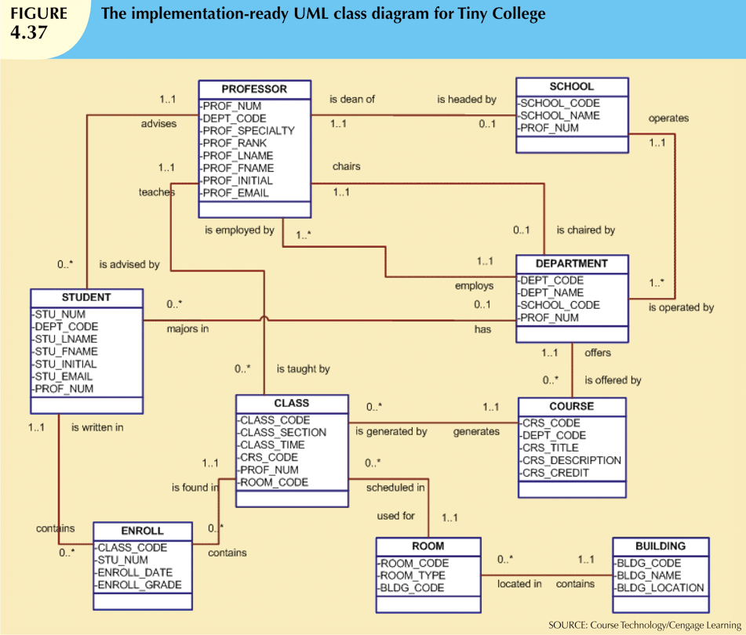
UML
Notation
instead of
Crow’s Feet.

